Slide 1
Residential Occupancies
Determine what differentiates this type of occupancy from others
Identify the key provisions that are different from the general chapters

Slide 2
Historic Fire
Winecoff Hotel

Slide 3
People
Types of people present
  Familiarity
  Abilities
Activities

Slide 4
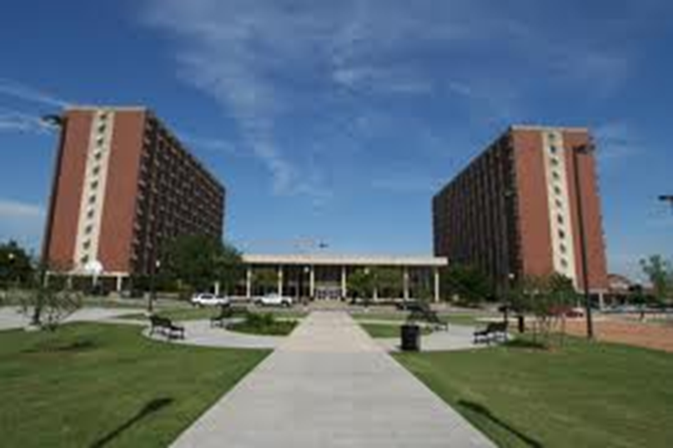
Occupancy Classifications- Residential
Sleeping
R-1: Transient people
R-2: Permanent people
  More than two units

Slide 5
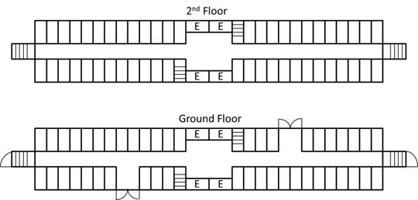
Hotels and Dormitories
Means of escape
Remoteness rules do not apply
  No common path outside of rooms
Internal discharge
Travel distance and common path requirements

Slide 6
Detection and Suppression
Corridor smoke detection
Local smoke alarms in rooms
CO detection
Voice alarms can be required
Some guest rooms with strobes
Generally, sprinkler systems
  All rooms exit to outside
  Portable fire extinguishers
Grab bars

Slide 7
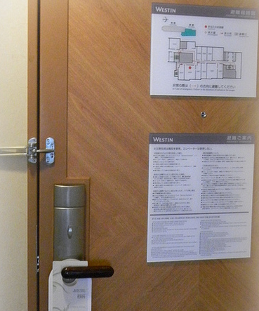
Drills and Emergency Plans
Emergency plans provided
Hotels: Employees drilled quarterly on duties
  Must start annunciation
  Must notify fire department
Dormitories: Drills frequently enough, at times of peak occupant load
Risk analysis for dorms

Slide 8
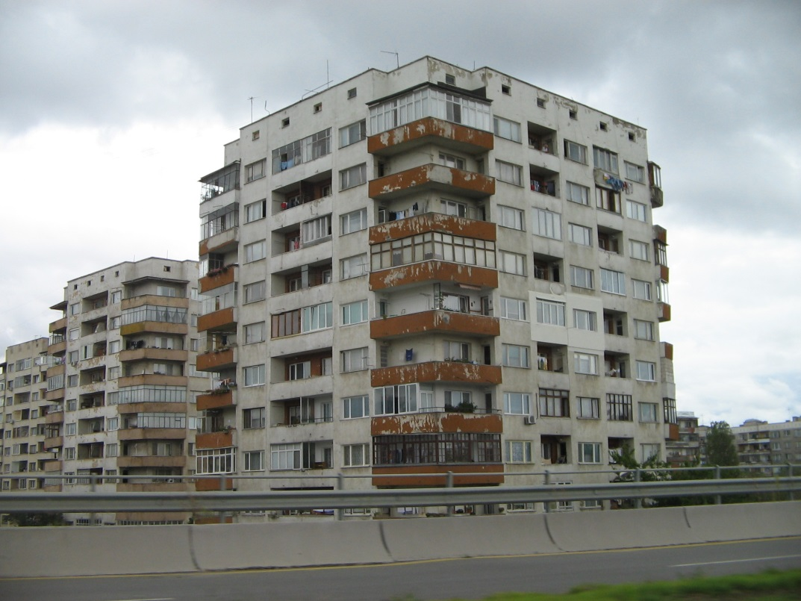
Apartments
Means of egress similar to Hotels
Less fire alarm requirements
Annual instructions to each dwelling unit

Slide 9

Homes
R-3
Single family
  Three outsiders
Means of escape
Lesser requirements
  28” doors
  36” stairs
  7’ ceiling height
Unlock bathroom doors from outside
Grab bars
Smoke alarms
CO detection
Sprinklers
Existing chapter reserved

Slide 10
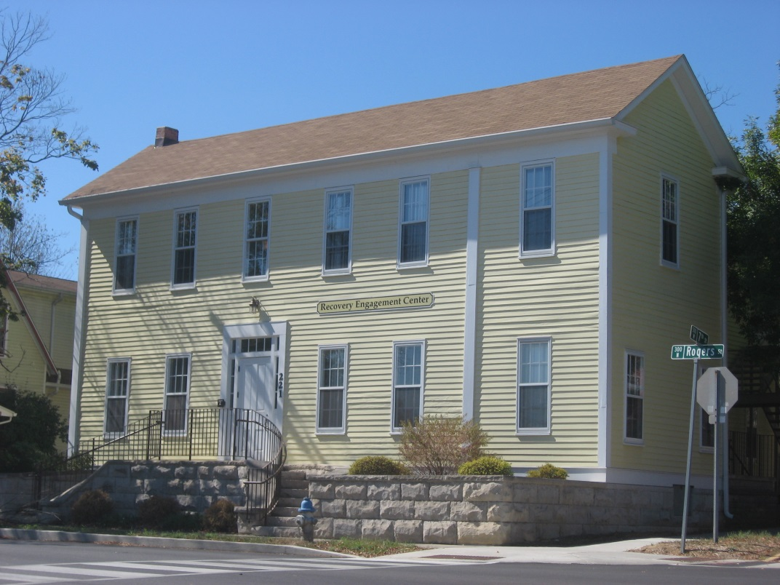
Lodging or Rooming Houses
16 or fewer people
R-2
Similar requirements as homes
Additional fire and smoke spread limitations
Interior finish requirements
Fire alarm
  Strobes
Existing chapter reserved

Slide 11
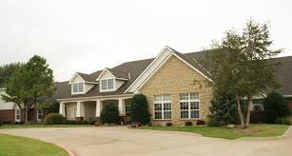
Occupancy Classifications- Residential
R-4: Custodial care
  6-16 people
  Condition 1: Can self-evacuate
  Condition 2: Any person needs limited assistance

Slide 12
Residential Board and Care
Small Facilities
Large Facilities
R-4: Custodial care
  6-16 people
  Condition 1: Can self-evacuate
  Condition 2: Any person needs limited assistance
I-1 Supervised living
  16+ people, excluding staff
  24-hour care
  Condition 1: Can self-evacuate
  Condition 2: Limited assistance

Slide 13
Chapter Structure
32.1 General Requirements
32.2 Small Facilities
32.3 Large Facilities
32.4 Suitability of Apartment Buildings
32.7 Operating Features

